Slide 1
Chapter 5: C Language and the Use of PIC18
C Compiler
The PIC18 Microcontroller
Han-Way Huang
Minnesota State University, Mankato
June 2004

Slide 2
Introduction to C Language
C language is gradually replacing assembly language in many embedded applications.
C language allows the user to work on the program logic at a higher level than the assembly language.
A C program consists of functions and variables.
A function contains statements that specify the operations to be performed.
A C statement could be declaration, assignment, function call, control, and null.
A simple C program is as follows:
#include <stdio.h>
main (void)
{
int a, b, c;
a = 3;
b = 5;
c = a + b;
printf(“ a + b = %d \n”, c);
return 0;
}

Slide 3
Types, Operators, and Expressions
Variables and constants are the basic objects in C.
Variables must be declared before they can be used.
Both the name and the type of the variable must be included in the declaration.
A variable name may start with a letter (A through Z or a through z) or underscore character followed by zero or more letters, digits, or underscore characters.
The variable name is case-sensitive.
Basic Data Types in C
1. void: used most commonly with functions
2. char: can hold a single byte of data
3. int: integer. The size of type int is 16 bits for PIC18.
4. float: 32-bit, single-precision, floating-point number
5. double: 64-bit double-precision, floating-point number (32-bit for PIC18)
- The PIC18 C compiler also supports the 24-bit short long integer data type.
Several modifiers can be applied to integer type including short, long, and unsigned.
Int and char types are signed by default.

Slide 4
Variable Declarations
A declaration specifies a type and contains a list of one or more variables of that type.
int i, j, k;
char cx, cy;
A variable may also be initialized when it is declared:
int i = 0;
char echo = ‘y’; /* ASCII of letter y is assigned */
Constants
1. integer
2. character
3. floating-point:
4. character: enclosed by single quotes
5. string: enclosed by double quotes

Slide 5
Radix of Numbers
1. decimal: default radix
2. octal: add prefix 0. e.g., 04321
3. hexadecimal: add prefix 0x. e.g., 0x3A4B
Arithmetic Operators
+, -, *, /, %, ++, --
Bitwise Operators
& AND PORTD = PORTD & 0x7F;
| OR PORTD = PORTD | 0x80;
^ XOR PORTD = PORTD ^ 0x0F;
~ NOT xyz = ~xyz;
>> right shift abc = abc >> 2;
<< left shift abc = abc << 4;

Slide 6
Arithmetic and logic operators are often used together with the = operator.
For example,
abc = abc + 3; can be written as abc += 3;
abc = abc >> 4; can be written as abc >>= 4;
xy = xy & 0x7F; can be written as xy &= 0x7F;
Relational and Logical Operators
== equal to (two ‘=’ characters)
!= not equal to
> greater than
>= greater than or equal to
< less than
<= less than or equal to
&& and
|| or
! not (one’s complement)

Slide 7
In C language,
- A statement is terminated by a colon.
- A compound statement is a group of statements enclosed by braces { and }.
A compound statement is not terminated by a semicolon.
A control-statement specify the order in which computations are performed.
Control Flow Statements
If statement
if (expression) if (a > b)
statement; PORTA |= 0x48;
If-else Statement
if (expression) if (ax == 0)
statement₁; abc = 3;
else else
statement₂; abc = 5;
if-else statement can be replaced by abc = (ax == 0)? 3:5;
the ?: operator.

Slide 8
Multiway Conditional Statement
if (expression₁)
statement₁;
else if (expression₂)
statement₂;
else if (expression₃)
statement₃;
…
else
statement_{n};
Switch Statement
switch (expression) {
case const_expr₁:
statement₁;
break;
case const_expr₂:
statement₂;
break;
…
default:
statement_{n};
}
if (k == 1)
return 2;
else if (k == 4)
return 5;
else
return 0;
switch (i) {
case 1: set_temp (50);
break;
case 2: set_pressure (30);
break;
…
default:
set_temp (20);
set_pressure(28);
break;
}

Slide 9
for-loop Statement
for (expr1; expr2; expr3)
statement;
where,
expr1 & expr3 are assignments or function calls
expr2 is a relational statement
Examples
count1 = 0;
for (i = 0; i < 30; i++)
if (arr[i] & 0x03) /* is arr[i] dividable by 4? */
count1 ++;
count2 = 0;
for (j = 30; j > 0; j--)
if ((arr[i] > 5) && (arr[j] < 20))
count2++;

Slide 10
while statement
while (expression)
statement;
do-while statement
do
statement_{x}
while (expression_{y})
goto statement
goto label;
The use of goto statement is not considered a good
programming style.
while (!(ADCON1 & 0x80)); /* null statement */
while (1) { /* infinite loop */
…
}
i = sum = 0;
do
sum = sum + i;
i++;
while (i < 50);
if (temperature > 100)
goto alarm;
…
alarm:
set_alarm(); /* call a function to
turn on alarm; */

Slide 11
Input and Output
Not part of C language.
ANSI standard defines a set of library functions for input and output that must be supported by the C compiler. Among them
The getchar ( ) function returns a character when it is called. The character is received from the serial communication port.
The putchar (int) outputs a character on the standard output device.
The puts (const char *s) function outputs the string pointed to by s to the standard output device.
The printf (formatting string, arg₁, arg₂, …, arg_{n}) function outputs the arguments to the standard output device using the supplied formatting string).
The Microchip PIC18 C compiler does not support the printf() function.

Slide 12
Functions and Program Structure
Every C program consists of one or more functions.
The definition of a function cannot be embedded within another function.
Values can be passed to a function through arguments.
A function may return a value to the caller using the return statement.
The syntax of a function definition is as follows:
return_type function_name (declarations of arguments)
{
declarations and statements
}
The following function converts a lowercase letter to uppercase:
char lower2upper (char cx)
{
if (cx >= ‘a’ && cx <= ‘z’) return (cx – (‘a’ – ‘A’));
}

Slide 13
- A function cannot be called before it has been defined.
- This dilemma is solved by using function prototype statement.
- The syntax for a function prototype statement is
return_type function_name (declarations of arguments);
Example 5.1 Write a C function to compute the average of an array of integers. Both the starting address of the array and the array count are passed to this function.
Solution:
int array_ave (int arr[ ], int ar_cnt)
{
short long int sum;
int i;
sum = 0;
for (i = 0; i < ar_cnt; i++)
sum += arr[i];
return (sum / ar_cnt);
}

Slide 14
Example 5.2 Write a function to compute the square root of a 32-bit number using the successive approximation method.
Solution:
unsigned sq_root (unsigned long int xz)
{
unsigned int sar, guess_mask, rest_mask;
unsigned int i;
sar = 0; /* successive approximation register is initialized to 0 */
guess_mask = 0x8000; /* this mask is used to guess the ith bit to be 1 */
i = 16;
do {
rest_mask = ~guess_mask; /* rest_mask is used to cancel the incorrect guess */
sar |= guess_mask; /* guess the ith bit to be 1 */
if (sar * sar > xz)
sar &= rest_mask; // change the bit to 0
guess_mask >> 1;
i--;
} while (i > 0);
if ((xy - sar * sar) < ((sar + 1)*(sar + 1) – xy))
return sar;
else return (sar + 1);
}

Slide 15
Example 5.3 Write a function to test whether an integer is a prime number.
Solution:
unsigned sq_root (unsigned long int xz);
/* this function returns a 1 if ka is prime. Otherwise, it returns a 0. */
char test_prime (unsigned long int ka)
{
unsigned int i, limit;
if (ka == 1) return 0;
else if (k2 == 2) return 1;
limit = sq_root (ka); /* find the square root of ka */
for (i = 2; i <= limit; i++)
if ((a % i) == 0) return 0;
return 1;
}

Slide 16
Example 5.4 Write a program to find out the number of prime numbers between 1000 and 10000.
Solution:
#include <stdio.h>
char test_prime (unsigned int a); /* prototype declaration of test_prime () */
unsigned sq_root (unsigned long int xz); /* prototype of sq_root () */
main ( )
{
unsigned int i, prime_count;
prime_count = 0;
for (i = 1000; i <= 10000; i++) {
if (test_prime(i))
prime_count ++;
}
printf(“\n The total prime numbers between 1000 and 10000 is %d\n”, prime_count);
}
/* include the functions sq_root () and test_prime () here */

Slide 17
Pointers and Addresses
A pointer is a variable that holds the address of a variable.
Pointers can be used to pass information back and forth between a function and its calling point.
Pointers provide a way to return multiple data items from a function via its arguments.
The syntax for declaring a pointer type:
type_name *pointer_name;
One can use the & operator to assign the address of a variable to a pointer variable.
One can use the * operator to access the value pointed to by a pointer variable.
For example,
int *ax;
char *cp;
int x, y;
ax = &x; /* assign the address of x to ax */
y = *ax; /* y gets the value of x */

Slide 18
Example 5.5 Write the bubble sort function to sort an array of integers.
Solution: A swap function is needed by the bubble sort.
void swap (int *, int *);
void bubble (int a[], int n) /* n is the array count */
{
int i, j;
for (i = 0; i < n – 1; i++)
for (j = 0; j < n – (i+1); j++)
if (a[j ] > a[j+1])
swap (&a[j], &a[j+1]);
}
void swap (int *px, int *py)
{
int temp;
temp = *px;
*px = *py;
*py = temp;
}

Slide 19
Arrays
An array holds one or multiple data items of common characteristics.
Each array element is referred to by specifying the array name followed by one or more subscripts, with each subscript enclosed in brackets.
Each subscript must be a nonnegative number.
The number of subscripts determines the dimensionality of the array.
High dimensional arrays are not used very often in 8- and 16-bit microcontroller applications.
A one-dimensional array can be expressed as
data_type array_name [expression];
A two-dimensional array is defined as
data_type array_name [expr1][expr2];
An array can be initialized when it is defined:
unsigned char led_pattern [10] = {0x7E, 0x30, 0x6D, 0x79, 0x33, 0x5B, 0x5F, 0x70, 0x7F, 0x7B};
char prompt [24] = “Please enter an integer:”;

Slide 20
Passing Arrays to a Function
An array name can be used as an argument to a function.
To pass an array to a function, the array name must appear by itself, without brackets or subscripts, as an actual argument within a function call.
An example is as follows:
int average (int n, int arr[]);
void main ( )
{
int n, avg; /* variable declaration */
int arr[50]; /* array definition */
…
avg = average(n, arr); /* function call */
…
}
int average (int k, int brr[]) /* function definition */
{
…
}

Slide 21
Structures
A structure is a group of related variables that can be accessed through a common name.
Each item within a structure has its own data type.
The syntax of a structure declaration:
struct struct_name { /* struct_name is optional */
type1 member1;
type2 member2;
…
}
The struct_name is optional, if it exists, defines a structure tag.
A struct declaration defines a type.
The right brace terminates the list of members and may be followed by a list of variables.
A structure definition not followed by a list of variables does not reserve any space.
An example,
struct catalog_tag {
char author [40];
char title [40];
char pub [40];
unsigned int date;
unsigned char rev;
} card;

Slide 22
An element of a structure can be accessed by the following two format:
1. structure-name.member
2. structure-pointer→member
An Example is as follows:
char cx, cy, cz;
struct health {
char weight;
char height;
char age;
char blood_press;
} ax, ay, *hptr;
cx = ax.weight;
cy = ax.height;
cz = hptr→age;

Slide 23
Union
May hold objects of different types and sizes with the compiler keeping track of size and alignment requirements.
Allow one to manipulate different kinds of data in a single area of storage without embedding any machine dependent information in the program.
Syntax of the union is
union union_name {
type-name1 element₁;
type-name2 element₂;
…
type-namen element_{n};
};
The union_name field is optional, when exists, is called a union tag.
Union variables can be declared at the same time when a union type is declared.

Slide 24
An example of union
union u_tag {
int i;
char c[4];
} temp;
The access of union members is similar to structure type:
union-name.member
union-pointer→member

Slide 25
Automatic/External/Static/Volatile
A variable defined inside a function is an internal variable.
Internal variables are automatic. They come into existence when a function is entered and disappear when it is left.
External variables are defined outside of any function and may be accessible by many functions.
An internal variable can be made into static by adding the keyword static when it is declared.
A static variable will maintain its value over function calls.
When a variable is declared static outside all the functions in a file, its scope is limited to the file in which it is declared.
A volatile variable has a value that can be changed by something other than the user code.
I/O ports and timer registers are examples of volatile variables.
Compiler makes no assumption on the value of a volatile variable and won’t perform any optimization on the volatile variable.

Slide 26
Project Build Process of the Microchip PIC18 C Compiler
Source code entering and editing
Object code generation
Library files creation and maintenance (optional). The user can optionally put related reusable function modules in a single library file.
Program linking and executable code generation
The whole process is shown in Figure 5.2.
The file output.hex can be downloaded into the target hardware for execution.
The fle output.cod provides information needed in debugging process.
The file output.lst contains the source code side by side with final binary code and line numbers.
The file output.out is an intermediate file used by the linker to generate cod file, hex file, and listing file.
The file output.map shows the memory layout after linking.

Slide 27
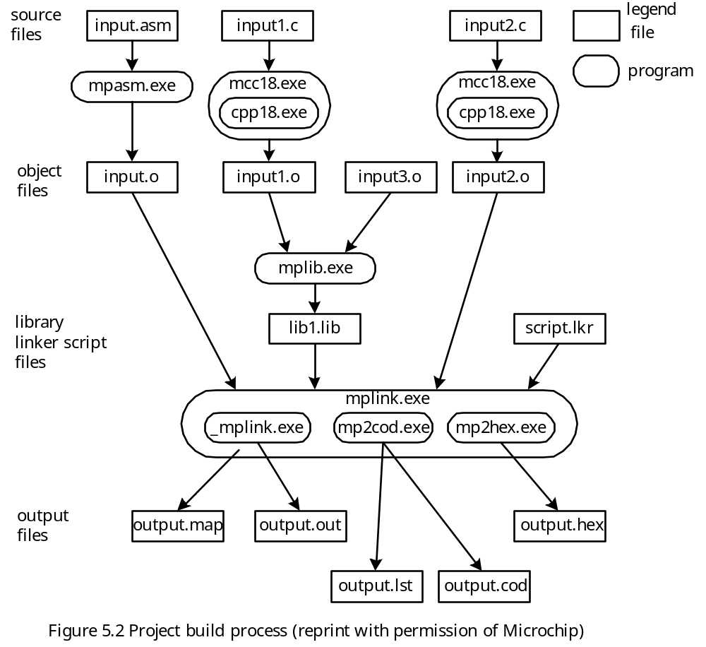

Slide 28
The MPLINK Linker Functions
Locating code and data
Resolving addresses
Generating an executable
Configuring stack size and location
Identifying address conflicts
Providing symbolic debug information
A linker file (with a suffix .lkr to the file name) must be added to the project to provide the above function.
The linker file without debug support for the PIC18F8720 is shown in Figure 5.3a. The linker file with debug support for the PIC18F8720 is shown in Figure 5.3b.

Slide 29
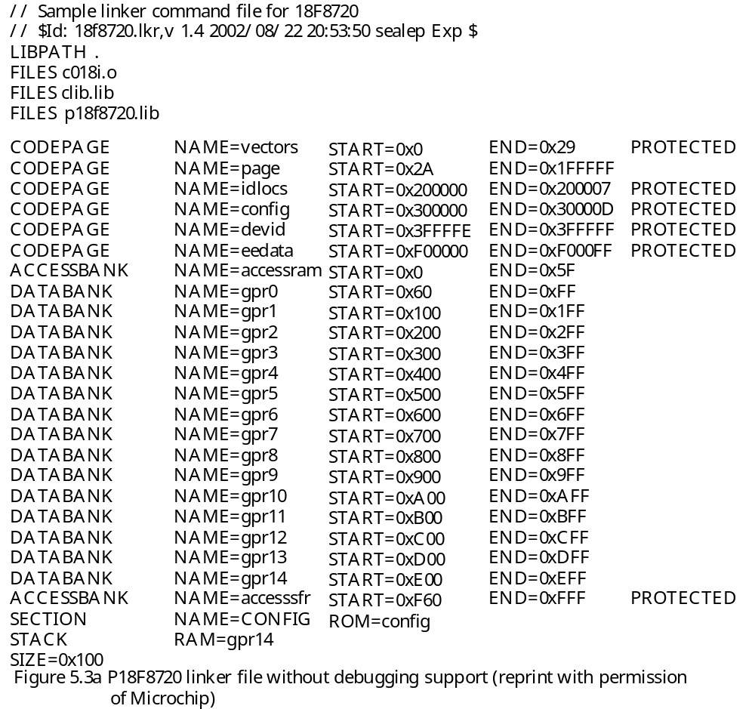

Slide 30
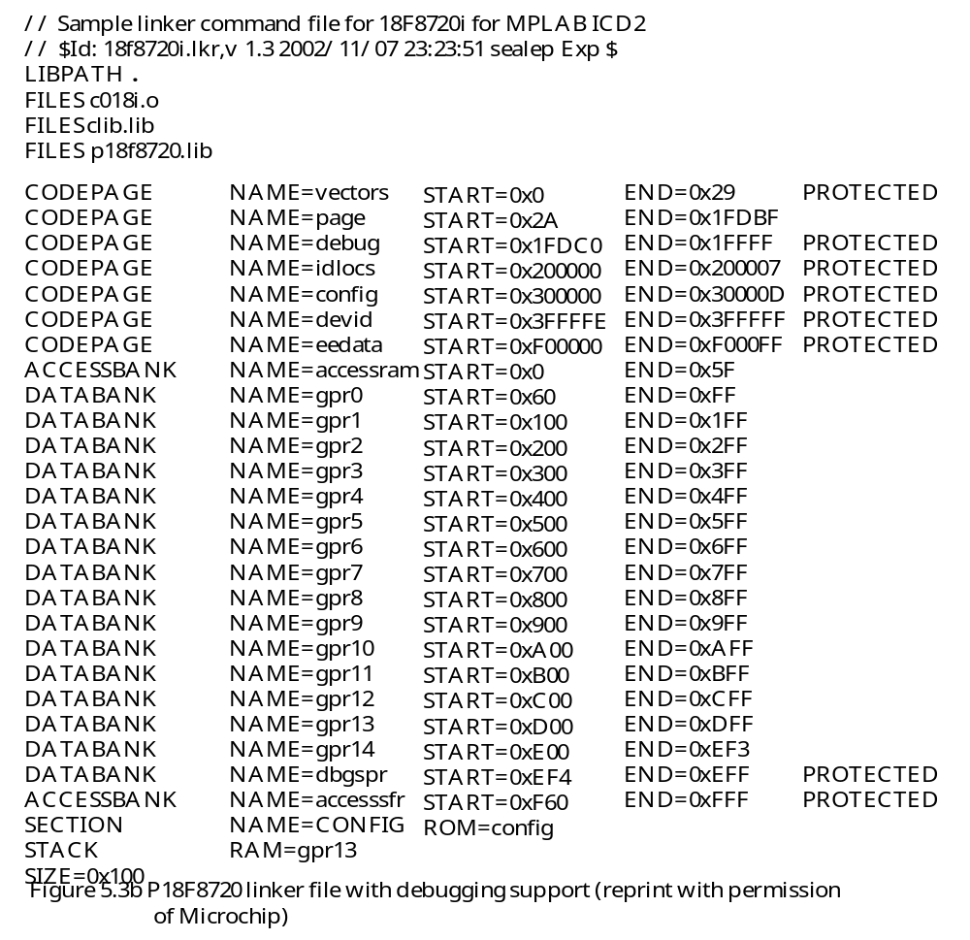

Slide 31
Inline Assembly
The MPLAB C compiler provides an internal assembler that allows the user to enter a block of assembly instructions into the C program.
The block of instructions must begin with _asm and end with _endasm.
Some restrictions to inline assembly apply:
1. No directive support
2. Comments must be C or C++ notation
3. Full text mnemonics must be used for table reads/writes, that is
- TBLRD (not TBLRD*)
- TBLRDPOSTDEC (not TBLRD*-)
- TBLRDPOSTINC (not TBLRD*+)
- TBLRDPREINC (not TBLRD+*)
- TBLWT (not TBLWT*)
- TBLWTPOSTDEC (not TBLWT*-)
- TBLWTPOSTINC (not TBLWT*+)
- TBLWTPREINC (not TBLWT+*)
4. No defaults for instruction operands—all operands must be specified.
5. Default radix is decimal.
6. Label must include colon.

Slide 32
Example of in-line assembly
-asm
clrf count,0
loop:
movlw 0x20 // check loop count
cpfseq count,0 // “
goto doit
goto done
doit:
movf sum_lo,0,0 // move sum_lo to WREG
addwf count,0,0 // add count to sum_lo
movwf sum_lo,0 // update sum_lo
movlw 0 // add carry to high byte of sum
addwf sum_hi,1,0 // “
incf count,1,0
goto loop
done:
nop
-endasm

Slide 33
Bit Field Manipulation
The processor-specific header file includes a structure definition that allows the user to access individual bits of a register by
1. appending bits to the register name
2. appending a period to the symbol resulted in step 1
3. specifying the bit name after the period
For example,
PORTBbits.RB0 = 1; /* pull PORTB bit 0 to high */
PORTBbits.RB1 = 0; /* pull PORTB bit 1 to low */
STATUSbits.C = 0; /* clear the C flag to 0 */

Slide 34
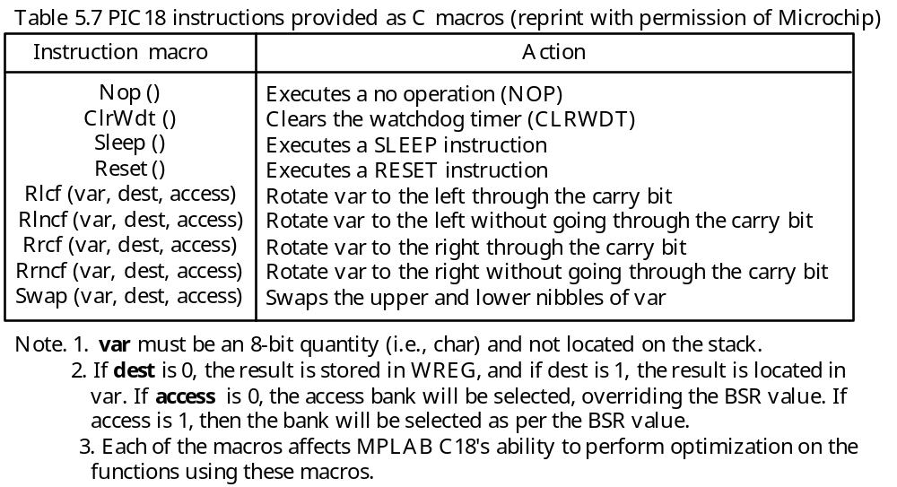
PIC18 Instructions Provided as Macros

Slide 35
The #pragma Statement
A compiler writer can add implementation-dependent options to the language by using the #pragma statement including
1. declare data or code sections
2. declare section attributes
3. locate code or data
4. declare interrupt vectors
5. declare interrupt service routines (to be discussed in Chapter 6)
6. other implementation-dependent features

Slide 36
MPLAB C18 Library Functions
- A library is a collection of functions grouped for reference and ease of linking.
C18 libraries are included in the lib subdirectory of the installation.
C libraries are divided into two groups: processor-independent libraries and processor-specific libraries.
Processor-Specific Libraries
Files contain definitions that may vary across different members of the PIC18 family.
These libraries include all the peripheral routines and the special-function definitions.
The processor-specific libraries are named pprocessor.lib. For example, the library for the PIC18F8720 is named p18F8720.lib.
Processor-Independent Libraries
General functions and math functions are in this category.
These functions are contained in clib.lib.

Slide 37
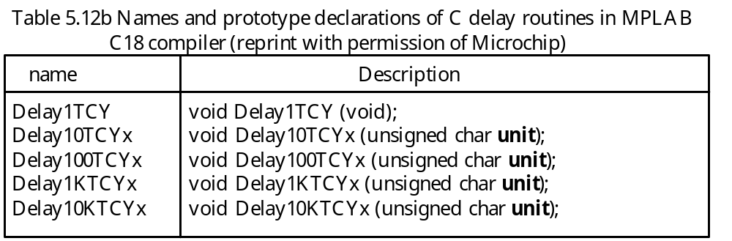
MPLAB C18 general library supports the following categories of routines:
Character classification functions
Data conversion functions
Delay functions
Memory and string manipulations
These library functions are listed in Table 5.10a, 5.10b, 5.11a, 5.11b, 5.12a, and 5.12b. The prototype definitions of delay functions are listed in Table 5.12b.

Slide 38
Creating time delay can easily be done by calling the appropriate delay functions. For example, with f_{OSC} = 32 MHz, instruction cycle time = 1/8 μs,
The following two statements can create 100 μs and 1 ms delays, respectively:
Delay100TCYx(8);
Delay1KTCYx(8);

